Slide 1

ATTINY85 USB “RUBBER DUCKY”
Creating a rubber ducky from an inexpensive programmable microcontroller and deploying a payload on a patched Windows 10 system.
Notes:
Hello, and welcome to my presentation.
My name is Nate, and I’m here to talk with you about a subject I find interesting in the cybersecurity field.
For this project and presentation, my goal was to create a USB rubber ducky from an inexpensive microcontroller and deploy a reverse shell on a patched windows system.

Slide 2
Why this Project?
I have several “hobbies” outside cybersecurity and computers that interest me, one of which being electronics prototyping and design.
Another being 3D Printing (more on that later).
After some initial searching, I found that you could use the Arduino IDE with an ATtiny85 to build a USB Rubber Ducky.
After further research, I discovered that deploying a reverse shell payload that will automatically connect to a remote computer would be a great proof of concept for this device.
Notes:
I have a lot of different hobbies and interests outside of cybersecurity and computers that interest me.
For instance , I have a small 3d printing addictions and really enjoy building projects with programmable microcontrollers using the Arduino platform.
After spending some time researching cybersecurity projects, I found you could build a device similar to a “rubber ducky” using a ATtiny85 microcontroller.
I then set about finding a use for the device and settled on opening a reverse shell inside a lab environment to connect to a simulated attacker’s computer.

Slide 3
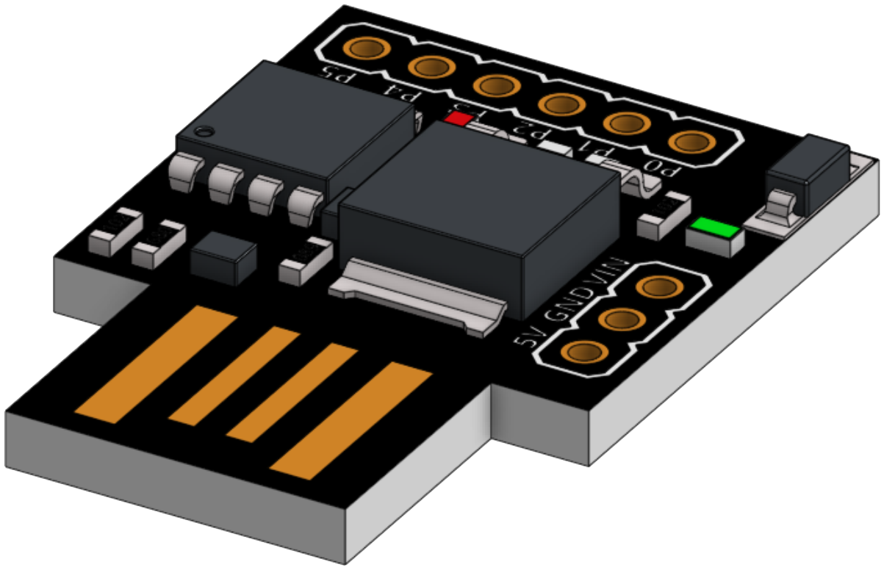
What is a ATtiny85 and “Rubber Ducky”.
An ATtiny85 is a prototyping or development board used for various electronic projects. Some examples might include: a countdown timer, FM radio, EMF detector, or bladeless fan (amongst countless others).
A “Rubber Ducky” is a physical device that emulates a keyboard and allows scripts to be written and deployed automatically when connected.
Notes:
A ATtiny85 is a very small development board which will run when power is supplied to the device.
There are numerous uses for such a device some examples are; a countdown timer, basic FM radio, EMF detector, bladeless fan (kind of like a dyson), amongst countless others.
A rubber ducky is a device developed to imitate a keyboard and type commands at superhuman speed. It automatically runs when connected to the computer.

Slide 4

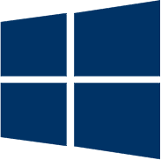
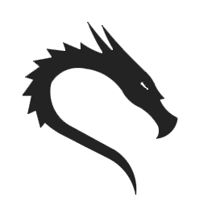
What is a reverse shell?
In a typical remote system access scenario, the user is the client, and the target machine is the server. The user initiates a remote shell connection, and the target system listens for such connections.
With a reverse shell, the roles are opposite. It is the target machine that initiates the connection to the attacker, and their computer listens for incoming connections on a specified port.
Windows VM
192.168.171.31
Kali (Linux) VM
192.168.171.29
Notes:
Understanding how a reverse shell works is crucial for my proof on concept.
A normal shell can be as simple as starting a SSH session where the client connects to the server.
In the most basic of terms a reverse shell in this case connects the target computer to the attacker’s computer. This is why its called a “reverse” shell.

Slide 5
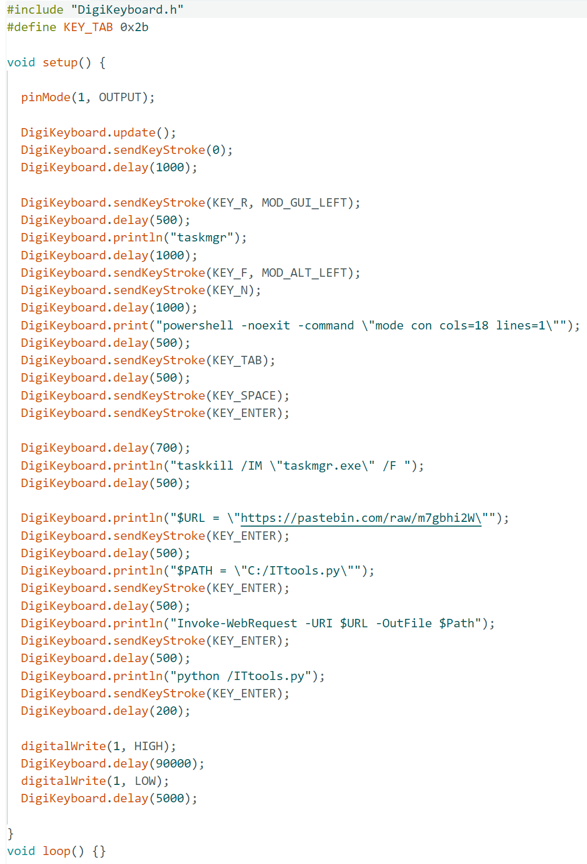
The code:
1
1. Add the correct library to use the AATtiny85 as a HID device and define the TAB key.
2. Define “pinMode” this will allow us to turn a LED on the board ON and OFF
3. Start sending the commands to launch Powershell as an ADMIN and make it a very tiny window to avoid detection.
4. Close “taskmgr”, we no longer need it.
5. Set a couple of variables ($URL and $PATH) for downloading the script from Pastebin. Then Download and run the code.
6. Turn the LED on to signify that that code was executed.
A. “DigitalKeyboard.sendKeyStroke” will type a modifier key.
B. “DigitalKeyboard.println” will type a string of letters (command).
C. “DigitalKeyboard.delay” will delay the script (in milliseconds).
2
3
4
5
6
Notes:
Here is the code I used for implanting the pay load and running the reverse shell script.
Basically, anything you can type, the ducky can do faster and more realiably.
For me the most difficult part of laying out the command chain, was getting the delays correct so the next command would not execute before the Powershell window would open or previous command would complete.

Slide 6
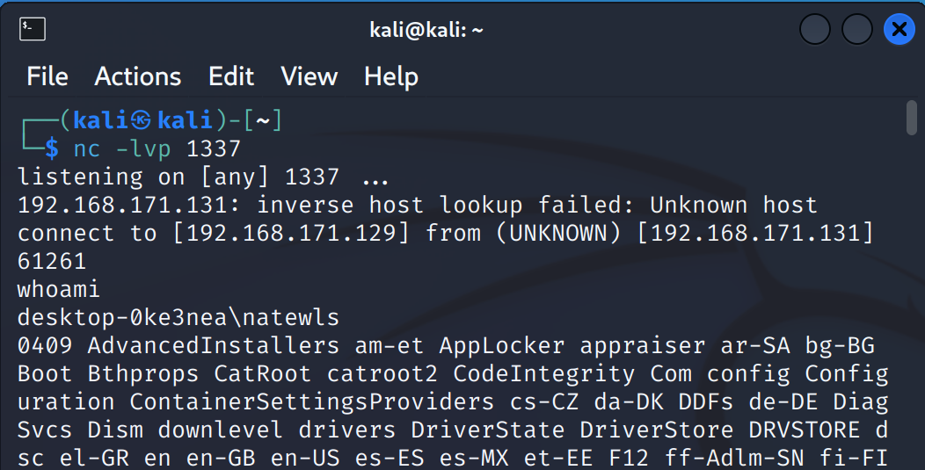






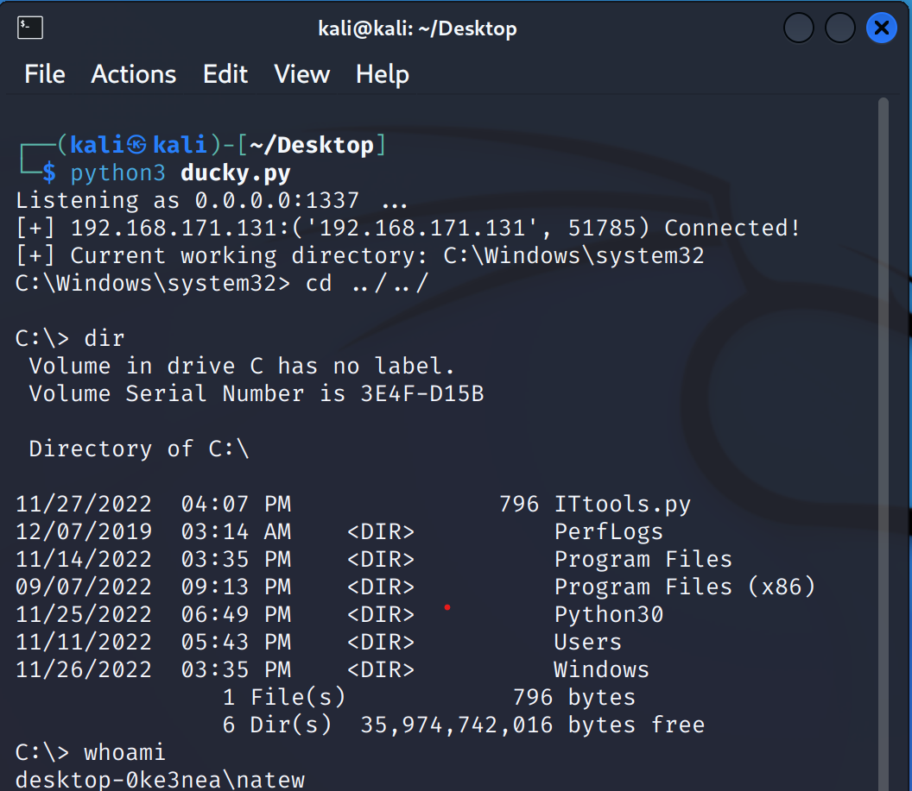
Payload Timeline.
Bypasses any protections from Windows defender and Windows Firewall to connect to the Kali computer (VM)
Begins dropping the ‘payload’ by opening a very small PowerShell window as an ADMIN.
Insert the USB Device into the computer (VM).
The device will download necessary drivers and tricks the computer in thinking it’s a HID keyboard.
Downloads the script from Pastebin and opens a reverse shell back to my Kali machine (VM).
Notes:
After inserting the device and connecting it to my Windows lab machine, I watched the commands to be sure they executed properly.
Everything seemed to work, so I switched to my Kali VM, and tried to execute a command, and it also worked.
However, the formatting seemed a little clunky to read for my taste (as you can see from the top right image). So back to google, and after some searching, I found a guide on creating a reverse shell using a couple of python scripts.
After some further testing, I deployed the new scripts (one for the server, one for the client) to discover a much easier to read layout. As you can see from the bottom right image.

Slide 7
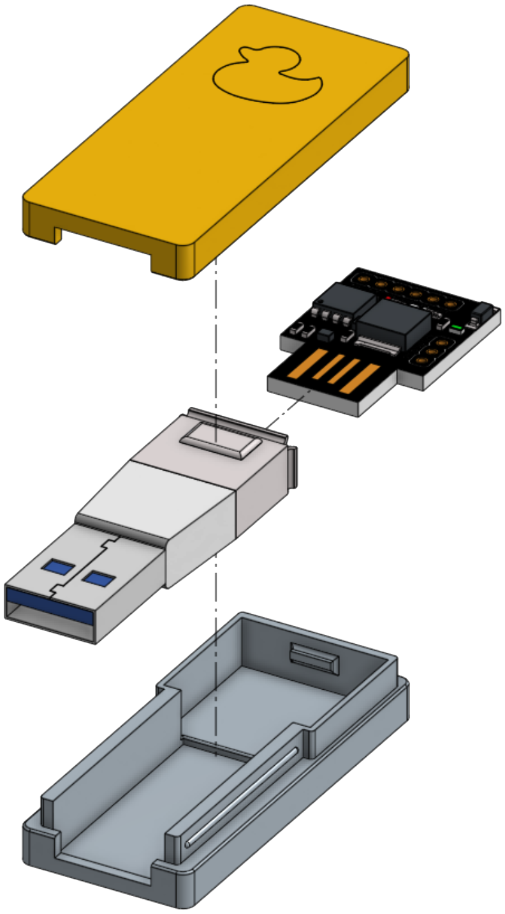
Hiding in plain sight.
Plugging a “circuit board” in your computer might be fun, 3D printing a case for the board to “hide” is even better.
Designed the case using Onshape, after a few iterations the final version successfully accomplished my goal of making the drive look harmless.
Notes:
I also designed a case around the board to “hide” it in plain sight. Making it a little less obvious that you are connecting a hacking device and not a simple thumb drive.

Slide 8
DEMONSTRATION
Notes:
An now for a quick demonstration of this attack.

Slide 9
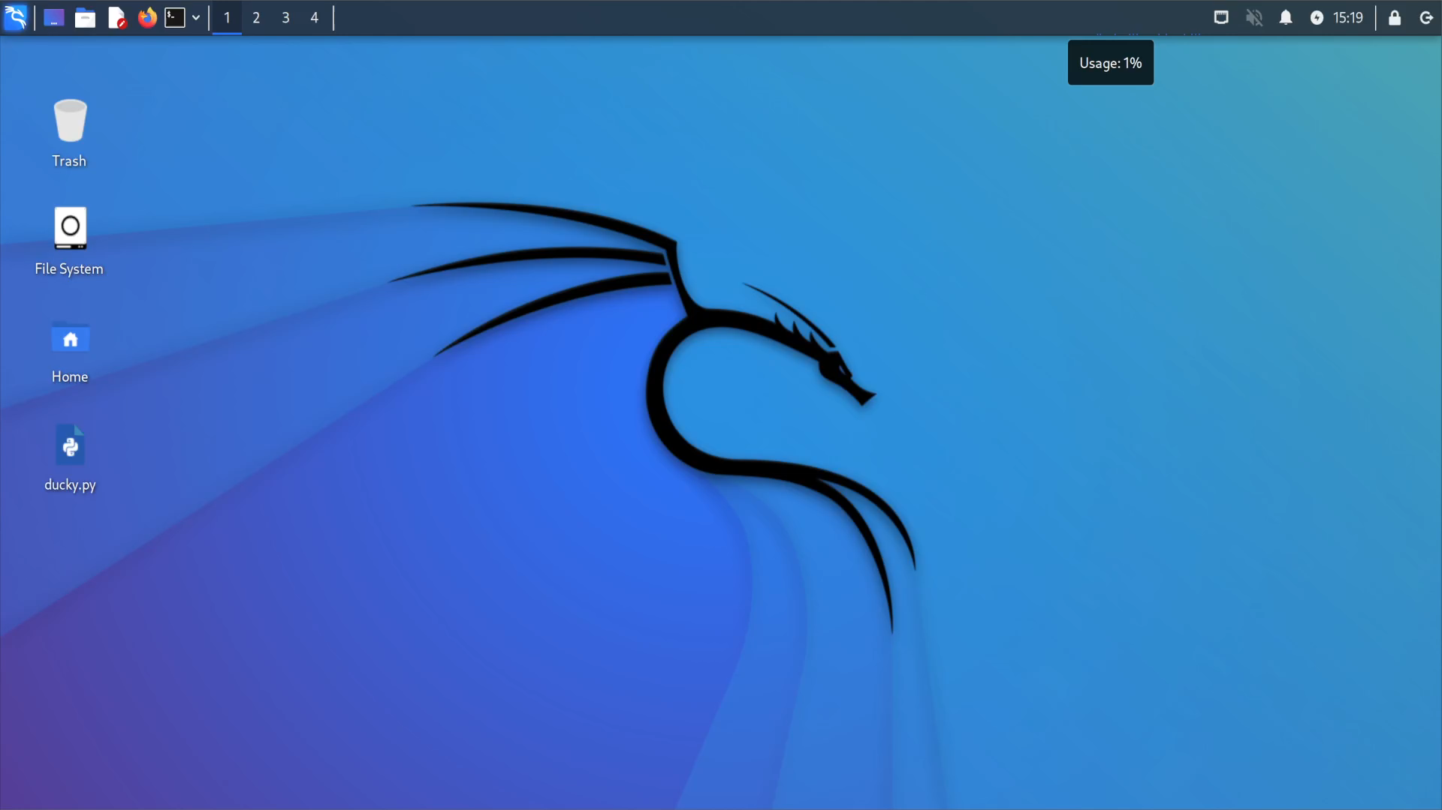
Notes:
First, a little setup within Kali, I am opening a terminal window and navigating to the “Desktop” directory where the python script is located.
The script will open a listener, on port 1337 on any IP on the network.

Slide 10
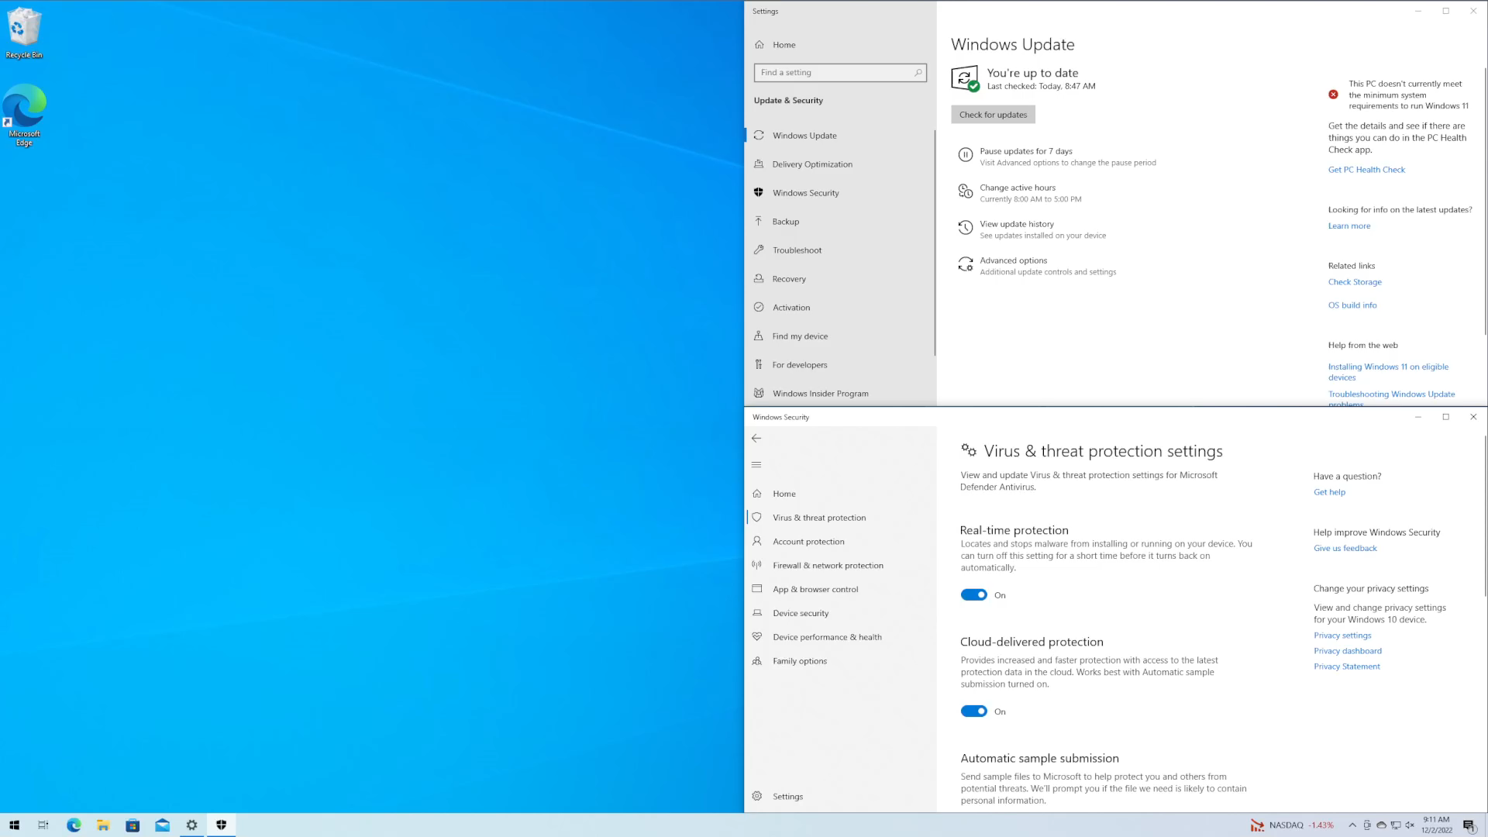
Notes:
Switching over to the Windows VM, here I am showing that both Windows Firewall and Defender are both ON.
I will now plug the rubber ducky into the system, if this is its first use it will download a necessary driver and then run. Tricking the computer into thinking it is a
After inserting the Rubber Ducky into the system, you can see the payload preforms as designed and downloading the script and executing the reverse shell.

Slide 11
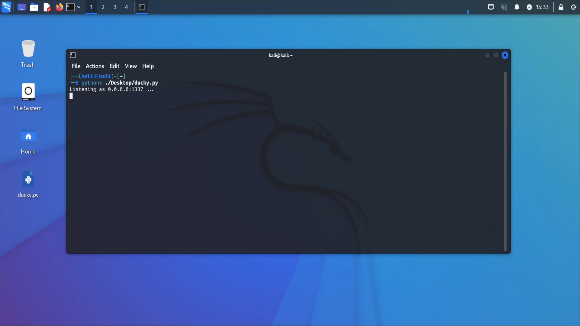
Notes:
Back to the Kali VM, the connection back from the Windows VM is successful.
To check and see if I can open programs on the Windows VM from the command line, I attempt to open the calculator.
I then change directories to the root of C to find the script (I titled it “ITtools.py”).

Slide 12
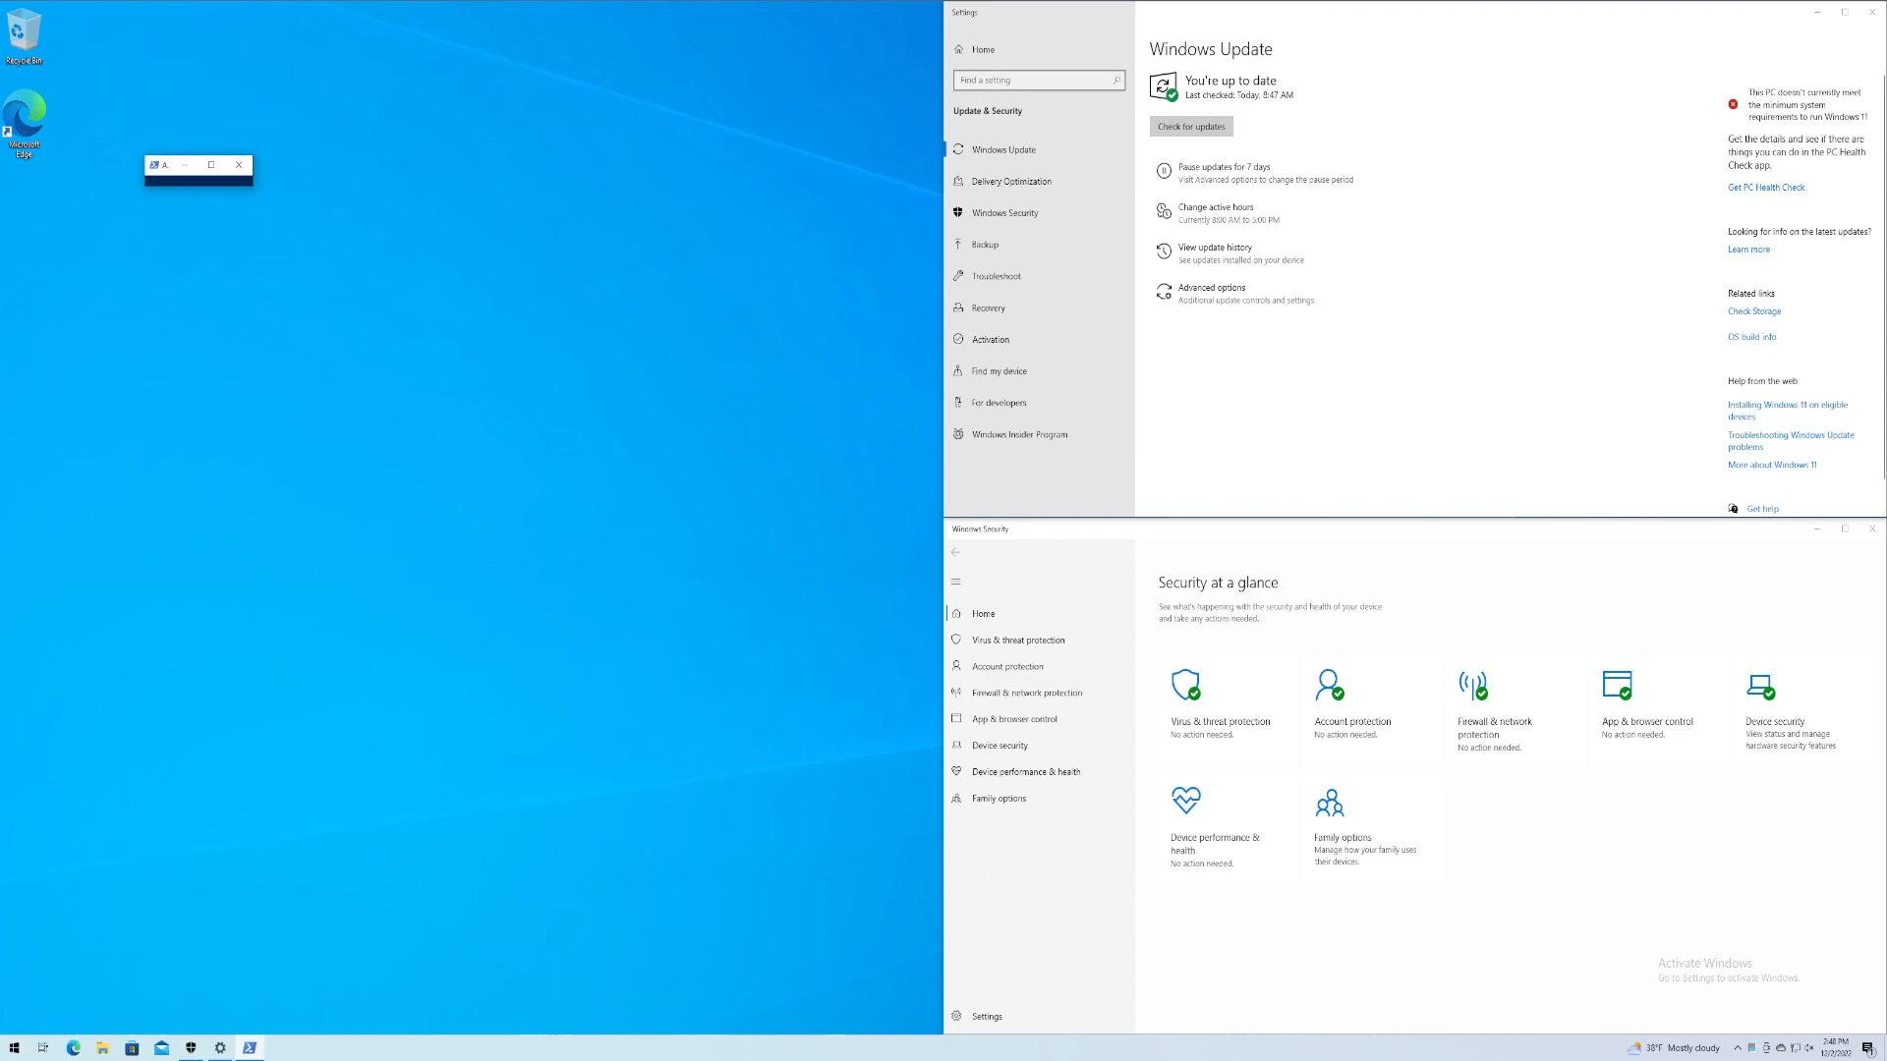
Notes:
Back to the windows VM, as the attack is taking place, you can see that the calculator does in fact launch.
Other than the tiny Powershell window, there is really no indication that a remote user is accessing files or running commands.

Slide 13
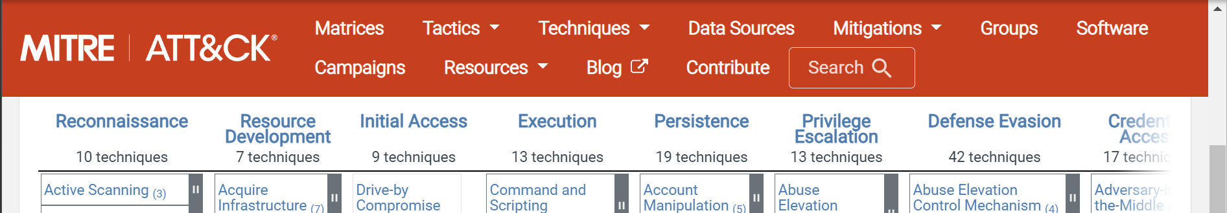
Huh?!
This attack method is covered in the MITRE ATT&CK framework in the “initial access” section and its technique is “Hardware Addition”.
Mitigation and detection against this attack could be any or all of the following:
Apply the principal of least privilege access, if this account did not have ADMIN access, none of these commands would have been successful.
Block unknown devices and accessories by endpoint security configurations and monitoring agents.
Don’t ever plug in unknown devices, incorporate this principal into cybersecurity training materials.
Notes:
Scary, right?
This attack is covered in the Mitre Att&ck framework under hardware additions.
Mitigation would be to apply the principal of least priveledge, block unknown devices and accessories, you could also block ALL devices from being connected to the machine through the group policy on the machine.
And please, don’t plug in an unknown device. Train your employees (at the minimum) annually to do the same.

Slide 14


THANKS, & ENJOY YOUR CONFERENCE
linkedin.com/nateward-mn
github.com/nateward1/ATtiny85-Ducky
Notes:
Thank you for letting me speak to you today, please see my github for any notes guides and files related to this project (including the files for 3d printing your own case). Please use them responsibly within the confines of the law.
Are there any questions?
Thanks again.

